Slide 1
Foundational Programming Concepts Introduction and Review
As part of Module 1
CC2 – Introduction to Computer Programming
Bretz Harllynne M. Moltio

Slide 2
Table of Contents
Algorithms – introduction and review
Computer program – introduction and review

Slide 3
Introduction to the Algorithm
Described in different ways:
Well-defined procedure that allows an agent to solve a problem
Clear and unambiguous specification of steps needed to solve a problem
Precise “recipe” of solving a problem, so there must be "ingredients" and steps to solve the problem
Procedure for solving a problem in terms of the actions to be executed and the order in which those actions are to be executed; agent is a computer or a robot

Slide 4
Introduction to Algorithms
An algorithm must:
Be well-ordered and unambiguous;
Have every operation effectively computable; and
Terminate

Slide 5
Creating an Algorithm Making a Peanut Butter and Jelly Sandwich
Make a peanut butter and jelly sandwich.
Eat.

Slide 6
Creating an Algorithm Making a Peanut Butter and Jelly Sandwich
Put peanut butter and jelly between two slices of bread.
Eat.

Slide 7
Creating an Algorithm Making a Peanut Butter and Jelly Sandwich
Grab some bread.
Get some peanut butter and jelly.
Grab a knife.
Spread the peanut butter on the bread.
Spread the jelly on top of the peanut butter.
Put peanut butter and jelly between two slices of bread.

Slide 8
Creating an Algorithm Making a Peanut Butter and Jelly Sandwich
if bag is closed
open bag
if loaf is already sliced
remove two slices from open end
otherwise (it isn't sliced)
remove bread from bag
cut two slices of bread from loaf
put slices on table separately
open the jar of peanut butter
if jar is sealed
unseal jar
pick up knife
put knife in peanut butter
scoop out 2 tablespoons of peanut butter
...and so on.

Slide 9
Elements of an Algorithm
Variables
Named memory location that can store a value
Box into which one can store and value, and from which one can retrieve a value
Only one value is meant to be stored by box
Type of value to be placed on the box usually depends on the size of the memory

Slide 10
Elements of an Algorithm
Operations
Action that allows the manipulation of one or more variables
Allow for the program to fulfill its goals and end the program
Types:
Primitive (input, assignment, output)
Conditional
Looping

Slide 11
Problem Analysis – Creating Algorithms
Problem: The radius of a circle is equal to one unit. Compute the corresponding area of a circle and print out the value of the area.
Problem Analysis:
Input: radius, pi
Process: area= radius*radius*pi
Output: area

Slide 12
Expressing Algorithms
Natural language
Programming language
Pseudocode
Flowcharting

Slide 13
Natural Language
Language that a human would be able to read, write, speak, and understand
Whatever language rules that the language has is followed in the creation of the algorithms
Characteristics:
Most understandable, regardless of the IT level
Allows for the detail necessary for an algorithm
Can also be quite vague at times
Humans typically use their natural language which at times can be too rich, ambiguous, and will depend on the language

Slide 14
Natural Language - Example
Define the value of radius r and pi (3.1416)
Calculate the area of the circle , area = r *r * pi
Print out the radius and the computed area

Slide 15
Programming Language
Comprises of words, statements, and rules to produce different types of machine output
Construction is very similar to a natural language but has lesser ambiguity
Characteristics:
Not recommended due to how rigid the rules of a programming language is
When solving a problem, it is best to be able to think at a certain abstract level so that more options can be explored
Shifts the emphasis of how to solve the problem to tedious details of syntax and grammar

Slide 16
Pseudocode
Algorithm in a natural language, but structured to look more like a programming language
Artificial and informal language that helps programmers develop algorithms
Characteristics:
Simple, readable, has very little rules, and doesn't worry much about details like punctuation
Allows one to think at an abstract level about the problem
Contains only instructions that have a well-defined structure and resemble programming languages

Slide 17
Pseudocode - Example
NUMBER r, area.
INPUT r.
area=3.14*r*r.
OUTPUT area.

Slide 18
Flowcharting
Flowchart
Picture of the separate steps of a process which is usually presented in a sequential order
Generic type of tool that can visually express an algorithm
Flowcharting
Process of creating the flowchart
Can also include the problem analysis

Slide 19
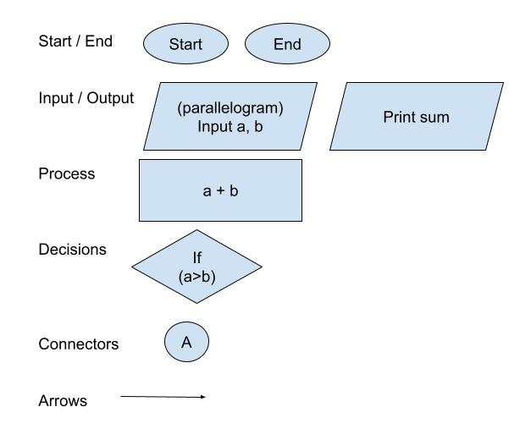
Parts of a Flowchart

Slide 20
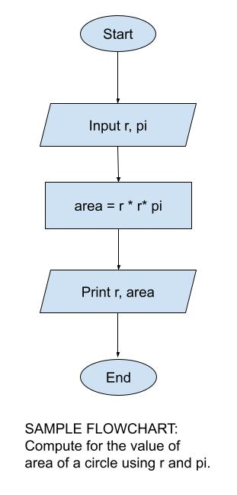
Flowchart - Example

